Slide 1
Software Cost Estimation & Quality Assurance

Slide 2
Software cost components
Three parameters to compute total cost of software development project:
Hardware and software costs including maintenance.
Travel and training costs.
Effort costs (the dominant factor in most projects)
-The salaries of engineers involved in the project;
-Social and insurance costs.
Effort costs must take overheads into account
- Costs of building, heating, lighting.
-Costs of networking and communications.
- Costs of shared facilities (e.g library, staff restaurant, etc.).

Slide 3
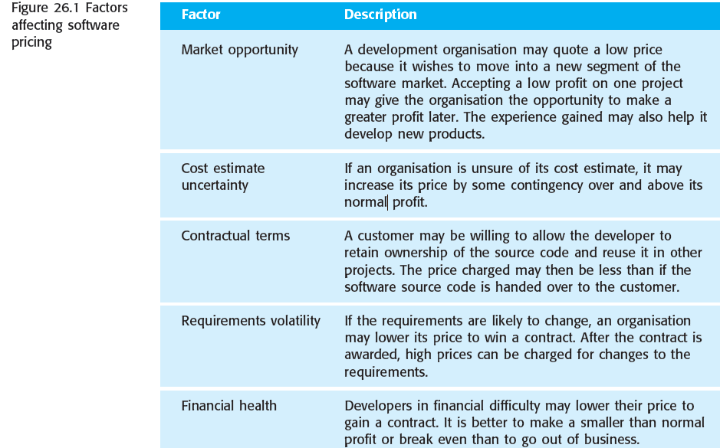
Software pricing factors

Slide 4
Estimation techniques
Estimation determines how much money, effort, resources, and time it will take to build a specific system or product. Estimation is based on:
Past Data/Past Experience
Available Documents/Knowledge
Assumptions
Identified Risks

Slide 5
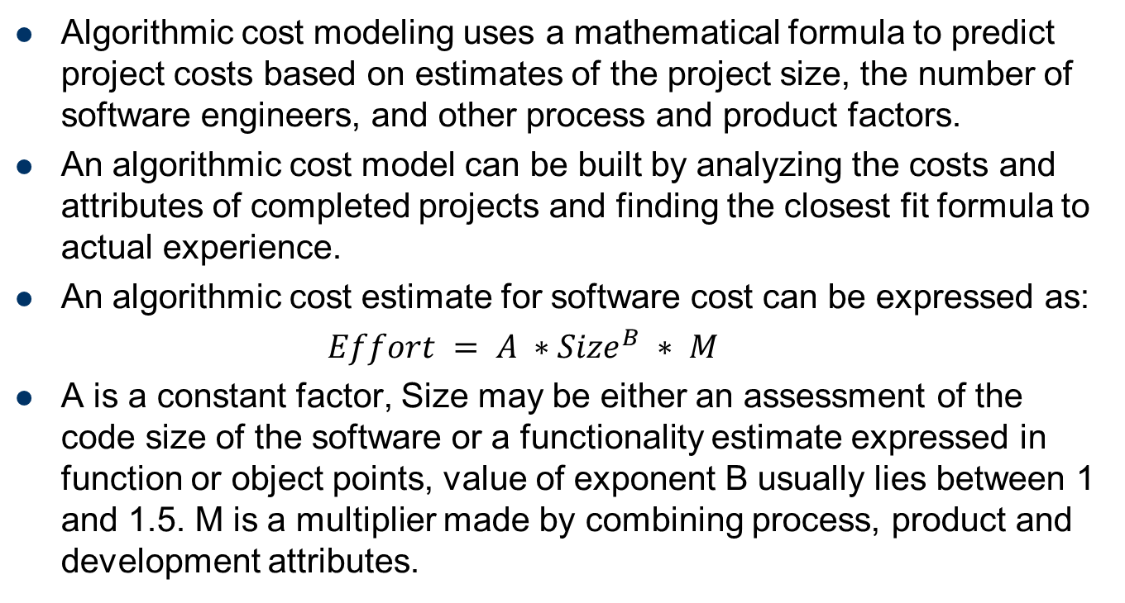
Algorithmic cost modeling
Algorithmic cost modeling uses a mathematical formula to predict project costs based on estimates of the project size, the number of software engineers, and other process and product factors.
An algorithmic cost model can be built by analyzing the costs and attributes of completed projects and finding the closest fit formula to actual experience.
An algorithmic cost estimate for software cost can be expressed as:
$Effort = A ∗{Size}^{B} ∗ M$
A is a constant factor, Size may be either an assessment of the code size of the software or a functionality estimate expressed in function or object points, value of exponent B usually lies between 1 and 1.5. M is a multiplier made by combining process, product and development attributes.

Slide 6
Algorithmic cost modeling
Most algorithmic estimation models have an exponential component (B in the above equation) that is associated with the size estimate.
This reflects the fact that costs do not normally increase linearly with project size. As the size of the software increases, extra costs are incurred because of the communication overhead of larger teams, more complex configuration management, more difficult system integration, and so on.
Therefore, the larger the system, the larger the value of this exponent.

Slide 7
Algorithmic cost modeling
All algorithmic models suffer from the same fundamental difficulties:
1. It is often difficult to estimate Size at an early stage in a project when only a specification is available. Function-point and object-point estimates are easier to produce than estimates of code size but are often still inaccurate.
2. The estimates of the factors contributing to B and M are subjective. Estimates vary from one person to another, depending on their background and experience with the type of system that is being developed.

Slide 8
The COCOMO (Constructive Cost Model)
COCOMO is one of the most widely used software estimation models in the world
It was developed by Barry Boehm in 1981
COCOMO predicts the effort and schedule for a software product development based on inputs relating to the size of the software and a number of cost drivers that affect productivity

Slide 9
The COCOMO (Constructive Cost Model)
COCOMO applied to
Organic mode: A development project can be considered of organic type, if the project deals with developing a well understood application program, the size of the development team is reasonably small, and the team members are experienced in developing similar types of projects.
Semidetached mode: A development project can be considered of semidetached type, if the development consists of a mixture of experienced and inexperienced staff. Team members may have limited experience on related systems but may be unfamiliar with some aspects of the system being developed.
Embedded mode: A development project is considered to be of embedded type, if the software being developed is strongly coupled to complex hardware, or if the stringent regulations on the operational procedures exist

Slide 10
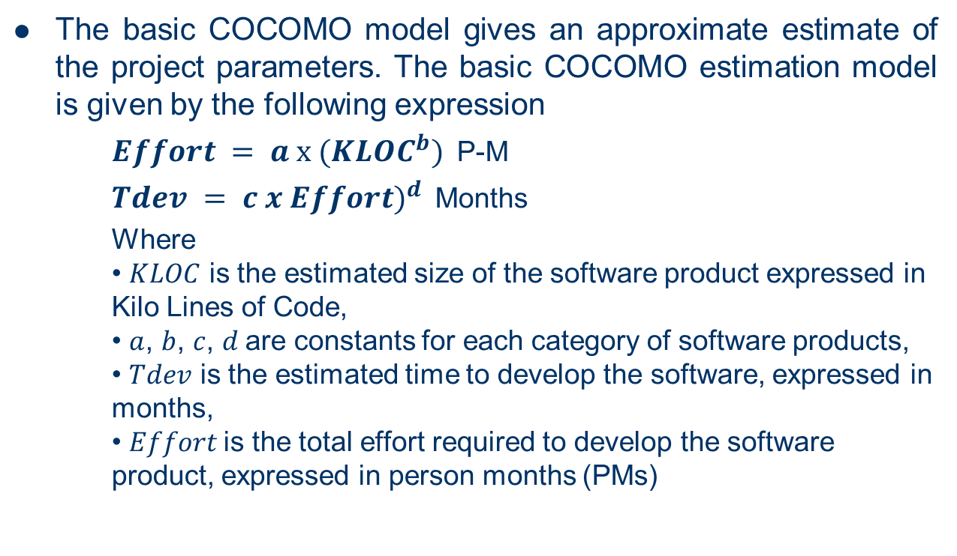
Basic COCOMO Model
The basic COCOMO model gives an approximate estimate of the project parameters. The basic COCOMO estimation model is given by the following expression
$Effort = a х ({KLOC}^{b})$P-M
$Tdev = c x {Effort)}^{d}$Months
Where • $KLOC$ is the estimated size of the software product expressed in Kilo Lines of Code, • $a$, $b$, $c$, $d$are constants for each category of software products, • $Tdev$ is the estimated time to develop the software, expressed in months, • $Effort$is the total effort required to develop the software product, expressed in person months (PMs)

Slide 11
Basic COCOMO Model Tables
project type: a b c d
organic 2.4 1.05 2.5 0.38
semi-detached 3.0 1.12 2.5 0.35
embedded 3.6 1.20 2.5 0.32
Example:
Suppose a project was estimated to be 400 KLOC. Calculate the effort and development time for each of the three mode i.e., organic, semi-detached & embedded.

Slide 12

Solution:
(i)Organic Mode
Effort = 2.4 * (400)^1.05 = 1295.31 P-M Tdev = 2.5 * (1295.31)^0.38=38.07 M
(ii)Semidetached Mode
Effort = 3.0 * (400)^1.12=2462.79 P-M Tdev = 2.5 * (2462.79)^0.35=38.45 M
(iii) Embedded Mode
Effortt = 3.6 * (400)^1.20 = 4772.81 P-M Tdev = 2.5 * (4772.8)^0.32 = 38 M
$Effort = a х ({KLOC}^{b})$P-M
$Tdev = c x {Effort)}^{d}$Months

Slide 13
Basic COCOMO Model Example (2)
Example 2: Based on the previous constant values, a project size of 200 KLOC is to be developed. Software development team has average experience on similar type of projects. The project schedule is not very tight. Calculate the Effort, development time, average staff size, and productivity of the project.
The semidetached mode is the most appropriate mode, keeping in view the size, schedule and experience of development time.
Hence Effort=3.0(200)^1.12=1133.12PM TDev=2.5(1133.12)^0.35=29.3M

Slide 14
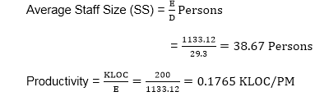
Basic COCOMO Model Example (2)

Slide 15
COCOMO 2 models
COCOMO 81 was developed with the assumption that a waterfall process would be used and that all software would be developed from scratch.
Since its formulation, there have been many changes in software engineering practice and COCOMO 2 is designed to accommodate different approaches to software development, reuse.

Slide 16
The sub-models in COCOMO-II are:
Application composition model. Used when software is composed from existing parts.
Early design model. Used when requirements are available but design has not yet started.
Reuse model. Used to compute the effort of integrating reusable components.
Post-architecture model. Used once the system architecture has been designed and more information about the system is available.

Slide 17
Quality Assurance
Quality Assurance is defined as the auditing and reporting procedures used to provide the stakeholders with data needed to make well-informed decisions
It is the Degree to which a system meets specified requirements and customer expectations
It is also monitoring the processes and products throughout the SDLC

Slide 18
Six Sigma for Software Engineering
Six Sigma is the most widely used strategy for statistical quality assurance. The Six Sigma strategy “is a rigorous/hard and disciplined methodology that uses data and statistical analysis to measure and improve a company’s operational performance by identifying and eliminating defects’ in manufacturing and service-related processes.
The Six Sigma methodology defines three core steps:
-Define customer requirements and deliverables and project goals via well defined methods of customer communication.
- Measure the existing process and its output to determine current quality performance (collect defect metrics).
- Analyze defect metrics and determine the vital few causes.

Slide 19
Six Sigma for Software Engineering
If an existing software process is in place, but improvement is required, Six Sigma suggests two additional steps:
- Improve the process by eliminating the root causes of defects.
-Control the process to ensure that future work does not reintroduce the causes of defects.
If an organization is developing a software process (rather than improving an existing process), the core steps are augmented as follows:
-Design the process to:
avoid the root causes of defects and
to meet customer requirements.
- Verify that the process model will, in fact, avoid defects and meet customer requirements

Slide 20
The ISO 9000 Quality Standards
ISO(International Organization for Standardization) 9000 is a set of international standards on quality management and quality assurance developed to help companies effectively document the quality system elements to be implemented to maintain an efficient quality system.
They are not specific to any one industry and can be applied to organizations of any size.

Slide 21
ISO 9000 principles of quality management
The ISO 9000:2015 and ISO 9001:2015 standards are based on seven quality management principles that senior management can apply for organizational improvement:
Customer focus
Leadership
Engagement of people
Process approach(small process or steps of development.)
Improvement
Evidence-based decision making
Relationship management

Slide 22
SEI CMM
CMM stands for Capability Maturity Model.
CMM is a method to evaluate and measure the maturity of the software development process of an organization.
CMM measures the maturity of the software development process on a scale of 1 to 5.
CMM v1.0 was developed by the Software Engineering Institute (SEI) at Carnegie Mellon University in Pittsburgh, USA.

Slide 23
CMM's Five Maturity Levels
CMM's Five Maturity Levels of Software Processes:
At the initial level, processes are disorganized, even chaotic. Success is likely to depend on individual efforts, and is not considered to be repeatable, because processes would not be sufficiently defined and documented to allow them to be replicated.
At the repeatable level, basic project management techniques are established, and successes could be repeated, because the requisite processes would have been made established, defined, and documented.

Slide 24
CMM's Five Maturity Levels
At the defined level, an organization has developed its own standard software process through greater attention to documentation, standardization, and integration.
At the managed level, an organization monitors and controls its own processes through data collection and analysis.
At the optimizing level, processes are constantly being improved through monitoring feedback from current processes and introducing innovative processes to better serve the organization's particular needs.

Slide 25
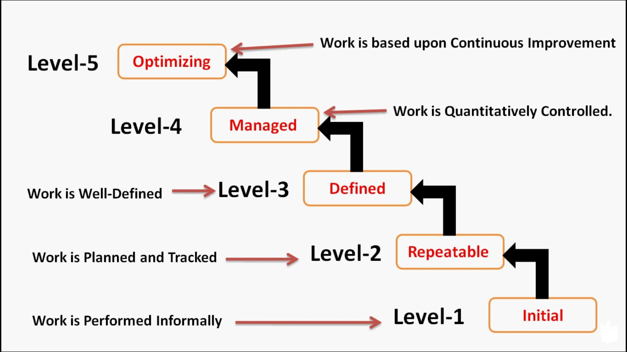
CMM's Five Maturity Levels

Slide 26
Difference between ISO 9000 and CMM(ISO 9000 VS CMM)
ISO 9000(INTERNATIONAL STANDARD ORGANISATION) | CMM (CABABILITY MATURITY MODEL)
It applies to any type of industry . | CMM is specially developed for software industry.
ISO 9000 provides pass or fail criteria. | It provides grade for process maturity.
ISO 9000 has no levels. | CMM has 5 levels: -Initial -Repeatable -Defined -Managed -Optimization

